Slide 1
Subtyping and Inheritance
Dirk Riehle, FAU Erlangen
ADAP B03
Licensed under CC BY 4.0 International

Slide 2
Agenda
What is subtyping?
Liskov substitutability principle
Applied to class hierarchies
Co- and contravariance
Multiple inheritance
Abstract superclass rule
Cascading class hierarchies
Homework

Slide 3
1. What is Subtyping?

Slide 4
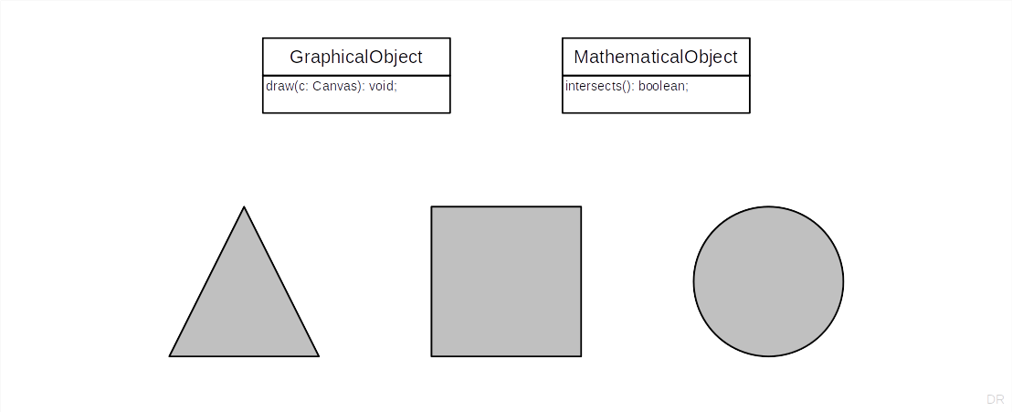
Subtyping Example 1 / 3

Slide 5
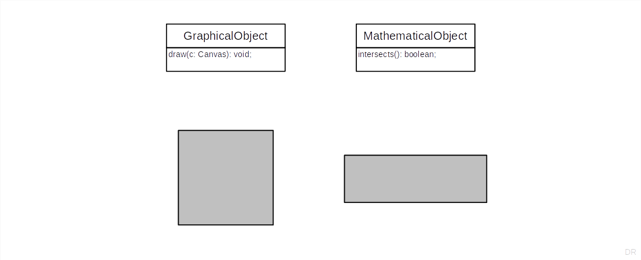
Subtyping Example 2 / 3

Slide 6
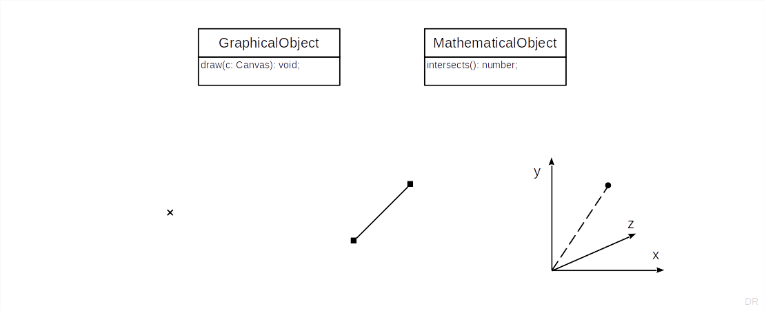
Subtyping Example 3 / 3

Slide 7
2. Liskov Substitutability Principle

Slide 8
The Subtype Requirement [1]
Let φ(x) be a property provable about objects x of type T. Then φ(y) should be provable for objects y of type S, where S is a subtype of T.
[1] A.k.a. the Liskov Substitutability Principle (LSP) [LW94]

Slide 9
In Simpler Words
All properties that hold for instances of a supertype should also hold for instances of a subtype [DR]

Slide 10
Even Simpler
Don’t surprise use-clients

Slide 11
Quiz: What’s the Surprise?
If you make Rectangle a subtype of Square?
If you make Square a subtype of Rectangle?
If you make 2DLine a subtype of Point?
If you make Point a subtype of 2DLine?

Slide 12
3. Applied to Class Hierarchies

Slide 13
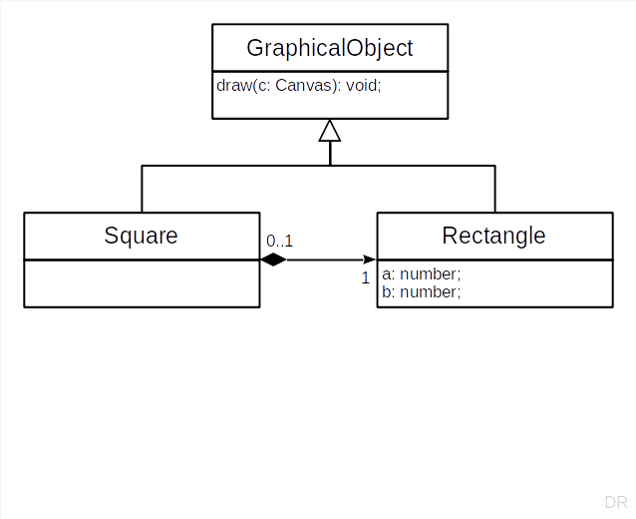
Subclasses as Extended Subtypes
Subclasses
Add methods and state
Do not constraint superclasses

Slide 14
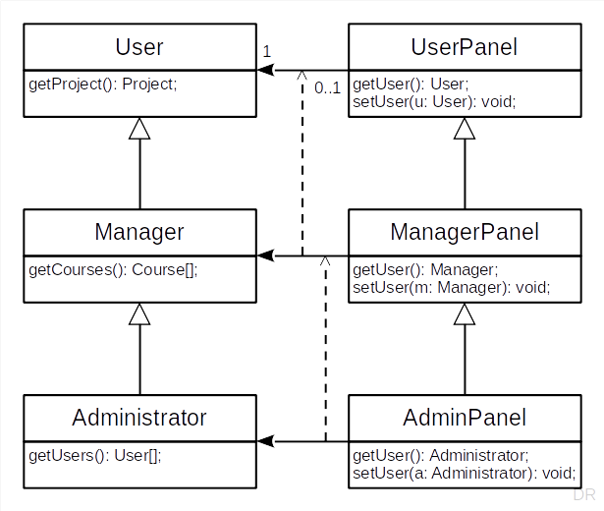
Subclasses as Constrained Subtypes
Subclasses
Constrain behavior in defined space
In method signatures
Using covariant redefinition
Leads to dual hierarchies

Slide 15
Extract Superclass Refactoring
A refactoring is a
Behavior-preserving transformation of existing code
The goal is to improve readability, remove redundancy, etc.
The extraction of an abstract superclass is a common refactoring
Fowler’s catalog [1] lists Extract Superclass (without “Abstract” though)
[1] Martin Fowler. Refactoring (2nd Edition). Addison Wesley, 2018.

Slide 16
4. Co- and Contravariance

Slide 17
Covariant Redefinition of Method Arguments
A method argument has been covariantly redefined, if
The type of the argument in the subtype is a subtype of the argument in the supertype’s method definition
Example of covariant redefinition of method argument
User.setUser(u: User): void → Manager.setUser(m: Manager): void
The subtype’s method “can only take less” than the supertype’s method promises
This violates the LSP and only makes sense if you think in relationships

Slide 18
Contravariant Redefinition of Method Arguments
The method of the subtype can take more than the supertype
Satisfies the LSP but makes little sense in practice

Slide 19
Covariant Redefinition of Return Values
A return value has been covariantly redefined, if
The type of the return value in the subtype is a subtype of the return value in the supertype’s method definition
Example of covariant redefinition of return value
UserPanel.getUser(): User → ManagerPanel.getUser(): Manager
The subtype’s method “returns less” than the supertype’s method promises
Does not violate the LSP (is within expectations)

Slide 20
Contravariant Redefinition of Return Types
The method of the subtype can return more than the supertype
Violates the LSP and makes little sense in practice

Slide 21
5. Multiple Inheritance

Slide 22
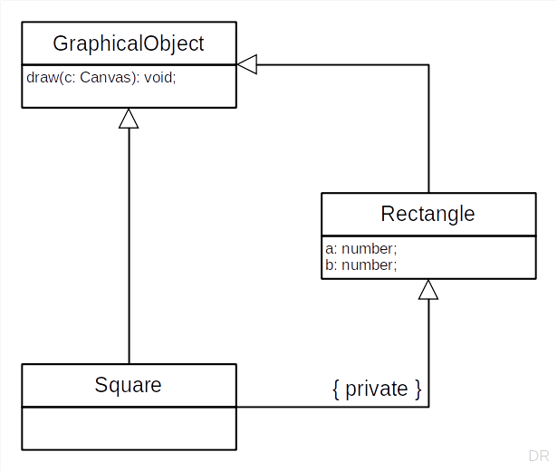
Multiple Inheritance
Multiple inheritance is when
A class has 2+ superclasses
Does not necessarily imply substitutability
Cf. C++’s private inheritance
Not a Typescript feature

Slide 23
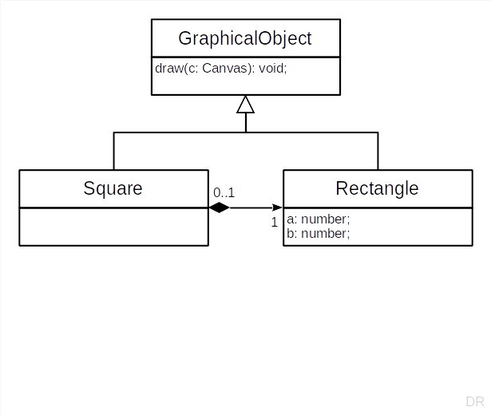
Implementation Delegation
Implementation delegation is when
A class delegates its implementation
Generally better than multiple inheritance
Choose delegation over inheritance

Slide 24
Composition over Inheritance
The composition over inheritance principle states that
You should favor object composition over class inheritance
A.k.a. delegation over inheritance (principle)

Slide 25
6. Abstract Superclass Rule

Slide 26
Inheritance vs. Abstractness
Inheritance is
A relationship between two classes
Abstractness / concreteness
A relationship between a class and its instances

Slide 27
Abstract Superclass Rule (ASR)
All superclasses must be abstract
Corollary: Never subclass a concrete class

Slide 28
ASR in Framework vs. Application
In a framework
Leaf classes may be abstract (awaiting subclassing)
Leaf classes may be concrete (if ready to use)
In an application (based on a framework)
Framework leaf classes may be abstract if unused
Application leaf classes must be concrete

Slide 29
ASR and LSP
The ASR helps to comply with the LSP
The ASR automatically casts subclasses as constrained subtypes

Slide 30
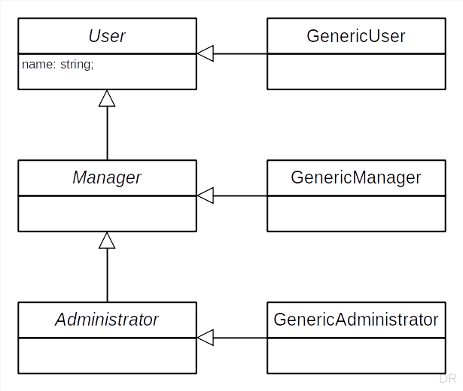
Pragmatics of ASR
Logically separate abstract class from generic implementation subclass
Pragmatically, merge implementation class into abstract class
Make abstract class concrete but maintain inheritance interface

Slide 31
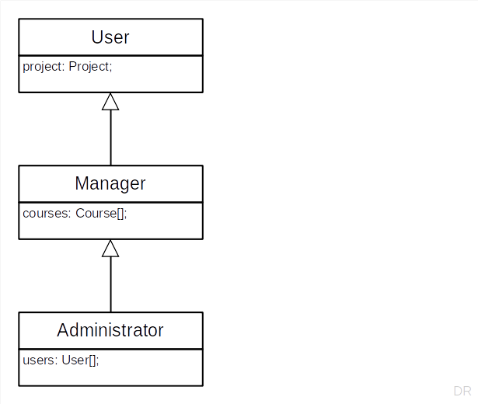
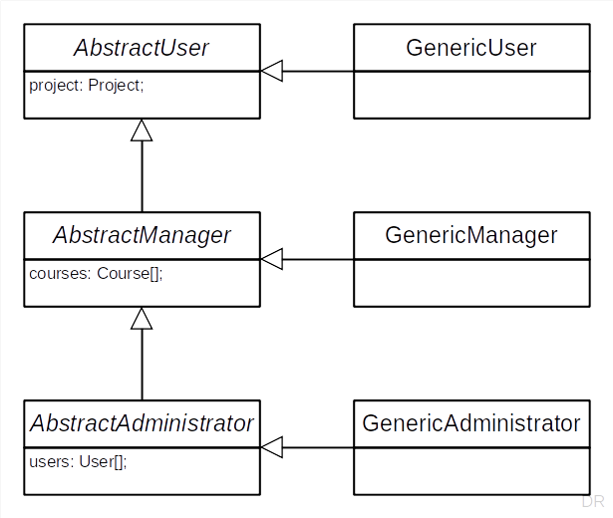
Class Hierarchy Evolution

Slide 32
7. Cascading Class Hierarchies

Slide 33
Before and After Methods
Before and after methods wrap a method’s main body
They typically come in pairs and are about a meta issue
The before method sets something up
The after method tears it down

Slide 34
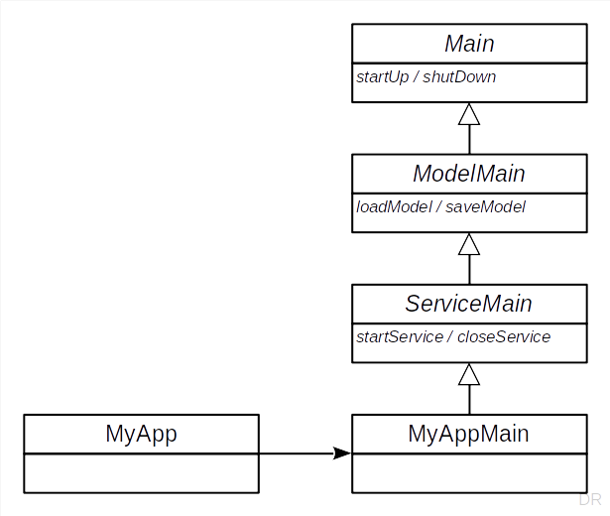
App with Service Example
import { MyAppMain } from "./MyAppMain";
function main(args: string[]) {
let appMain: MyAppMain = new MyAppMain();
appMain.run(args);
}
let args: string[] = process.argv;
args = args.slice(2);
main(args);

Slide 35
Cascading Inheritance Interfaces 1 / 2
export abstract class Main {
public run(args: string[]): void {
this.parseArgs(args);
this.startUp();
this.execute();
this.shutDown();
};
protected parseArgs(args: string[]): void {
// do nothing (expect subclass to override)
}
protected startUp(): void {
// do nothing (expect subclass to override)
}
protected abstract execute(): void;
protected shutDown(): void {
// do nothing (expect subclass to override)
}
}
import { Main } from "./Main";
export abstract class ModelMain extends Main {
protected startUp(): void {
super.startUp();
this.loadModel();
}
protected loadModel(): void {
// do nothing (expect subclass to override)
}
protected shutDown(): void {
this.saveModel();
super.shutDown();
}
protected saveModel(): void {
// do nothing (expect subclass to override)
}
}

Slide 36
Cascading Inheritance Interfaces 2 / 2
import { ModelMain } from "./ModelMain";
export abstract class ServiceMain extends ModelMain {
protected startUp(): void {
super.startUp();
this.startService();
}
protected startService(): void { /* ... */ }
protected execute(): void {
// start main event loop
}
protected shutDown(): void {
this.closeService();
super.shutDown();
}
protected closeService(): void { /* ... */ }
}
import { ServiceMain } from "./ServiceMain";
export class MyAppMain extends ServiceMain {
protected loadModel(): void {
// do something
}
protected startService(): void {
// do something
}
protected saveModel(): void {
// do something
}
protected closeService(): void {
// do something
}
}

Slide 37
Homework

Slide 38
Homework Instructions
Extract AbstractName superclass from StringName and StringArrayName
Identify and implement the narrow (minimal) inheritance interface
Move as much as you sensibly can into the AbstractName class
Adapt your previous work to this homework as you see fit
Commit homework by deadline to homework folder

Slide 39
Summary
What is subtyping?
Liskov substitutability principle
Applied to class hierarchies
Co- and contravariance
Multiple inheritance
Abstract superclass rule
Cascading class hierarchies

Slide 40
Thank you! Any questions?
dirk.riehle@fau.de – https://oss.cs.fau.de
dirk@riehle.org – https://dirkriehle.com – @dirkriehle

Slide 41
Legal Notices
License
Licensed under the CC BY 4.0 International license
Copyright
© 2012, 2018, 2024 Dirk Riehle, some rights reserved

